Slide 1
Software Life Cycles
(More Models
RAD & Agile)

Slide 2
Organization of This Lecture
Introduction to RAD
Working of RAD
Applicability of RAD Model
Comparison of RAD with Other Models
Application characteristics that render RAD unsuitable
Comparison of RAD with Other Models
AGILE DEVELOPMENT MODELS
Essential Idea behind Agile Models
Advantages and disadvantages of agile methods
Agile versus Other Models

Slide 3
RAPID APPLICATION DEVELOPMENT (RAD)
The rapid application development (RAD) model was proposed in the early nineties in an attempt to overcome the rigidity of the waterfall model (and its derivatives) that makes it difficult to accommodate any change requests from the customer.
It proposed a few radical extensions to the waterfall model. This model has the features of both prototyping and evolutionary models. It deploys an evolutionary delivery model to obtain and incorporate the customer feedbacks on incrementally delivered versions.
In this model prototypes are constructed, and incrementally the features are developed and delivered
to the customer. But unlike the prototyping model, the
prototypes are not thrown away but are enhanced and
used in the software construction.

Slide 4
The major goals of the RAD
To decrease the time taken and the cost incurred to develop software systems.
To limit the costs of accommodating change requests.
To reduce the communication gap between the customer and the developers.

Slide 5
Working of RAD
Development takes place in a series of short cycles or iterations.
At any time, the development team focuses on the present iteration only, and therefore plans are made for one increment at a time.
The time planned for each iteration is called a time box
Each iteration planned to enhance the functionality by only a small amount.
A quick-and-dirty prototype-style software for some functionality is developed.
The customer evaluates the prototype and gives feedback on the specific improvements.
The prototype is refined based on the customer feedback.
The development team almost always includes a customer representative to clarify the requirements.
The development team usually consists of about five to six members, including a customer representative

Slide 6
How does RAD facilitate accommodation of change requests?
The customers usually suggest changes to a specific feature only after they have used it.
Since the features are delivered in small increments, the customers are able to give their change requests pertaining to a feature already delivered.
Incorporation of such change requests just after the delivery of an incremental feature saves cost as this is carried out before large investments have been made in development and testing of a large number of features.

Slide 7
How does RAD facilitate faster development?
The decrease in development time and cost, and at the same time an increased flexibility to incorporate changes are achieved in the RAD model in two main ways—minimal use of planning and heavy reuse of any existing code through rapid prototyping. The lack of long-term and detailed planning gives the flexibility to accommodate later requirements changes. Reuse of existing code has been adopted as an important mechanism of reducing the development cost.
RAD model emphasises code reuse as an important means for completing a project faster. In fact, the adopters of the RAD model were the earliest to embrace object-oriented languages and practices. Further, RAD advocates use of specialised tools to facilitate fast creation of working prototypes.
These specialised tools usually support the following features:
. Visual style of development.
. Use of reusable components

Slide 8
Applicability of RAD Model
Customised software
Non-critical software
Highly constrained project schedule
Large software:

Slide 9
Application characteristics that render RAD unsuitable
Generic products (wide distribution)
Requirement of optimal performance and/or reliability
Lack of similar products
Monolithic entity

Slide 10
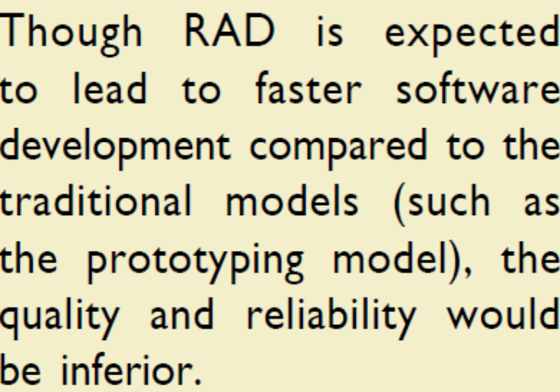
RAD versus prototyping model
In the prototyping model, the developed prototype is primarily used by the development team to gain insights into the problem, choose between alternatives, and elicit customer feedback.
The code developed during prototype construction is usually thrown away. In contrast, in RAD it is the developed prototype that evolves into the deliverable software.

Slide 11
RAD versus iterative waterfall model
In the iterative waterfall model, all the functionalities of a software are developed together.
In the RAD model the product functionalities are developed incrementally through heavy code and design reuse.
In the RAD model customer feedback is obtained on the developed prototype after each iteration and based on this the prototype is refined. Thus, it becomes easy to accommodate any request for requirements changes.
The iterative waterfall model does not support any mechanism to accommodate any requirement change requests. The iterative waterfall model does have some important advantages that include the following.
Use of the iterative waterfall model leads to production of good quality documentation which can help during software maintenance.
The developed software usually has better quality and reliability than that developed using RAD.

Slide 12
RAD versus evolutionary model
Incremental development is the hallmark of both evolutionary and RAD models.
In RAD each increment results in essentially a quick and dirty prototype, whereas in the evolutionary model each increment is systematically developed using the iterative waterfall model.
Also in the RAD model, software is developed in much shorter increments compared the evolutionary model. The incremental functionalities that are developed are of fairly larger granularity in the evolutionary model

Slide 13
AGILE DEVELOPMENT MODELS
Though the iterative waterfall model has been very popular during the 1970s and 1980s, developers face several problems while using it on present-day software projects.
The main difficulties include handling change requests from customers during product development, and the unreasonably high cost and time that is incurred while developing customised applications.
Capers Jones carried out research involving 800 real-life software development projects, and concluded that on the average 40 per cent of the requirements are arrived well after the development has already begun.
In this context, over the last two decades or so, several life cycle models have been proposed to overcome some of the glaring shortcomings of the waterfall-based models that become conspicuous when used in modern software development projects.

Slide 14
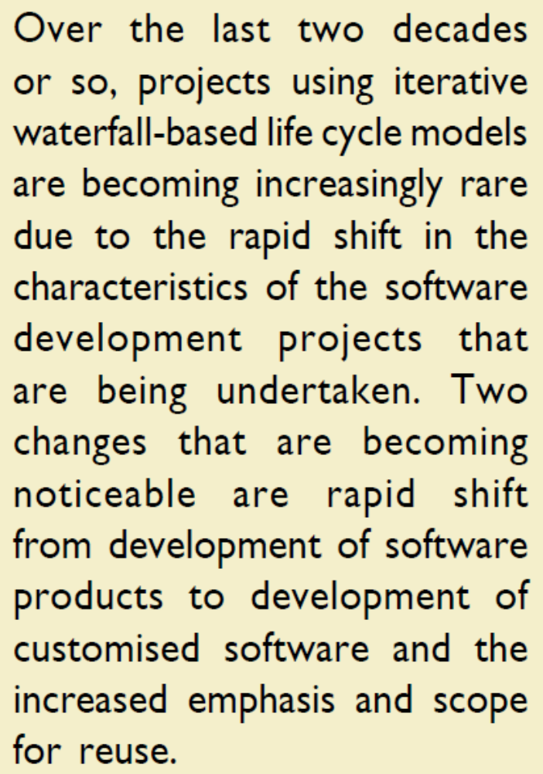
AGILE DEVELOPMENT MODELS

Slide 15
AGILE DEVELOPMENT MODELS
In the traditional iterative waterfall-based software development models, the requirements for the system are determined at the start of a development project and are assumed to be fixed from that point on.
The prevalence of customised application development can be gauged from the fact that the sales revenue generated worldwide from services already exceeds that of the software products. Iterative waterfall model is not suitable for development of such software.
Waterfall model is called a heavy weight model, since there is too much emphasis on producing documentation and usage of tools.
Waterfall model prescribes almost no customer interactions after the requirements have been specified.

Slide 16
AGILE DEVELOPMENT MODELS
The agile software development model was proposed in the mid-1990s to overcome the shortcomings of the waterfall model of development.
The agile model could help a project to adapt to change requests quickly. Thus, a major aim of the agile models is to facilitate quick project completion.
But, how is agility achieved in these models? Agility is achieved by fitting the process to the project. That is, it gave the required flexibility so that the activities that may not be necessary for a specific project could be easily removed. Also, anything that wastes time and effort is avoided.

Slide 17
AGILE DEVELOPMENT MODELS
Agile model is being used as an umbrella term to refer to a group development processes. While these processes share certain common characteristics, yet they do have certain subtle differences among themselves. A few popular agile SDLC models are the following:
„. Crystal
„. Atern (formerly DSDM)
„. Feature-driven development
„. Scrum
„. Extreme programming (XP)
„. Lean development
„. Unified process
In an agile model, the requirements are decomposed into many small parts that can be incrementally developed. The agile models adopt an incremental and iterative approach.
Each incremental part is developed over an iteration. Each iteration is intended to be small and easily manageable and lasts for a couple of weeks only. At a time, only one increment is planned, developed, and then deployed at the customer site. No long-term plans are made.

Slide 18
The time to complete an iteration is called a time box. The implication of the term time box is that the end date for an iteration does not change. That is, the delivery date is considered sacrosanct. The development team can, however, decide to reduce the delivered functionality during a time box if necessary.
A central principle of the agile model is the delivery of an increment to the customer after each time box.

Slide 19
Essential Idea behind Agile Models
For establishing close interactions with the customer during development and to gain a clear understanding of domain-specific issues, each agile project usually includes a customer representative in the team.
At the end of each iteration, stakeholders and the customer representative review the progress made and re-evaluate the requirements. The developed increment is installed at the customer site.
A distinguishing characteristics of the agile models is frequent delivery of software increments to the customer.

Slide 20
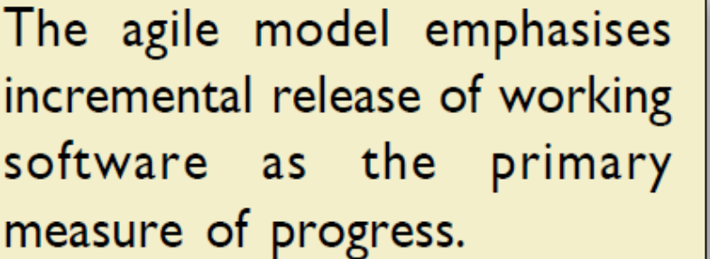
Essential Idea behind Agile Models
Agile models emphasise use of face-to-face communication in preference over written documents.
It is recommended that the development team size be kept small (5-9 people). This would help the team members to meaningfully engage in face-to-face communication and lead to a collaborative work environment.
It is implicit that the agile model is suited to the development of small projects.
However, can agile development be used for large projects with geographically dispersed team? In this case, the agile model can be used with different teams maintaining as much daily contact as possible through various communication media such as video conferencing, telephone, e-mail, etc.

Slide 21
Agile manifesto in 2001
„. Working software over comprehensive documentation.
„. Frequent delivery of incremental versions of the software to the customer in intervals of few weeks.
„. Requirement change requests from the customer are encouraged and are to be efficiently incorporated.
„. Having competent team members and enhancing interactions among them is considered much more important than issues such as usage of sophisticated tools or strict adherence to a documented process. It is advocated that enhanced communication among the development team members can be realised through face-to-face communication rather than through exchange of formal documents.
„. Continuous interaction with the customer is considered to be much more important than effective contract negotiation. A customer representative is required to be a part of the development team. This facilitates close, daily co-operation between customers and developers.

Slide 22
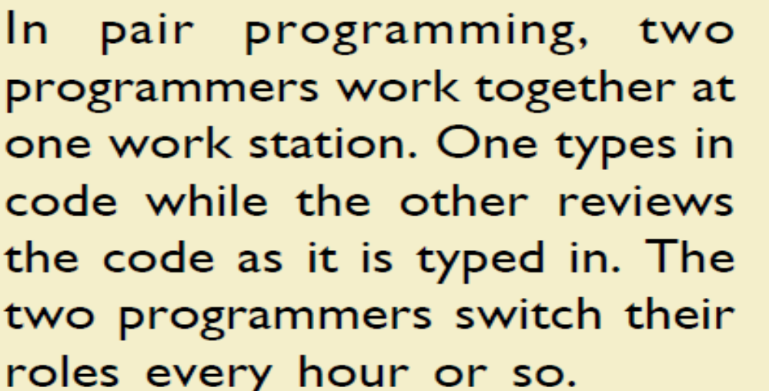
Agile manifesto in 2001
Agile development projects usually deploy pair programming.
Several studies indicate that programmers working in pairs produce compact well-written programs and commit fewer errors as compared to programmers working alone.

Slide 23
Advantages of agile methods
The agile methods derive much of their agility by relying on the tacit knowledge of the team members about the development project and informal communications to clarify issues, rather than spending significant amounts of time in preparing formal documents and reviewing them.
Though this eliminates some overhead

Slide 24
Disadvantages of agile methods
„. Lack of formal documents leaves scope for confusion and important decisions taken during different phases can be misinterpreted at later points of time by different team members.
„. In the absence of any formal documents, it becomes difficult to get important project decisions such as design decisions to be reviewed by external experts.
„. When a project completes and the developers disperse, maintenance can become a problem.

Slide 25
Agile model versus iterative waterfall model
The waterfall model is highly structured and makes a project to systematically step through requirements-capture, analysis, specification, design, coding, and testing stages in a planned sequence. Progress is generally measured in terms of the number of completed and reviewed artifacts such as requirements specification document, design documents, test plans, code reviews, etc. In contrast, while using an agile model, progress is measured in terms of the developed and delivered functionalities. In agile model, frequent delivery of working versions of the software is made. However, as regards to similarity it can be said that agile teams use the waterfall model on a small scale, repeating the entire waterfall cycle in every iteration.
If a project that is being developed using waterfall model is cancelled mid-way during development, then there is usually nothing to show from the abandoned project beyond several documents. With agile model however, even if a project is cancelled midway, it still leaves the customer with some worthwhile code, that might possibly have already been put into live operation..

Slide 26
Agile versus exploratory programming
Though a few similarities do exist between the agile and exploratory program development styles, there are vast differences between the two as well. Agile development model’s frequent re-evaluation of plans, emphasis on face-to-face communication, and relatively sparse use of documentation are similar to that of the exploratory style. Agile teams, however, do follow defined and disciplined processes and carry out systematic requirements capture and rigorous designs, as compared to the chaotic coding that takes place in exploratory programming.

Slide 27
Agile model versus RAD model
Agile model does not recommend developing prototypes, but emphasises systematic development of each incremental feature. In contrast, the central theme of RAD is to design quick-and-dirty prototypes, which are then refined into production quality code.
„. Agile projects logically break down the solution into features that are incrementally developed and delivered. The RAD approach does not recommend this. Instead, developers using the RAD model focus on developing all the features of an application by first doing it badly and then successively improving the code overtime.
„. Agile teams only demonstrate completed work to the customer. In contrast, RAD teams demonstrate to customers screen mock ups, and prototypes, that usually make several simplifications such as table look-ups rather than performing actual computations.

